Slide 1
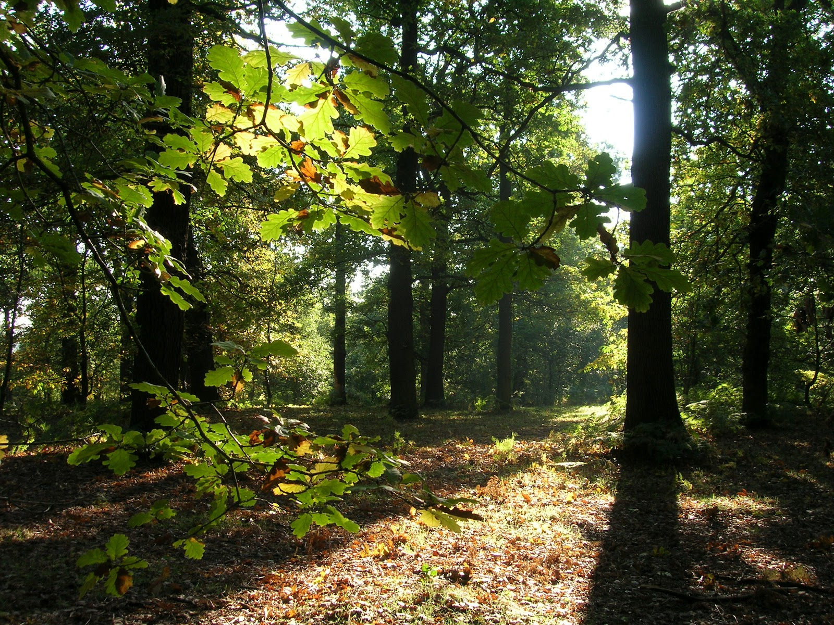
Predicting Carbon Stored (Biomass) in Forest Trees
For accurate quantification of how much carbon forest stores is essential for the successful functioning of carbon credits market.

Slide 2



Our Team:
Paul Hicks
Francisco Estrada
Jay Hombal

Slide 3
Agenda
Motivation for the capstone project
Dataset and challenges in computing Above Ground Biomass (AGB) stored in forest Trees
Data-Preprocessing
Matching Algorithm
Modeling Results
Closing Thoughts
Feedback Q & A

Slide 4

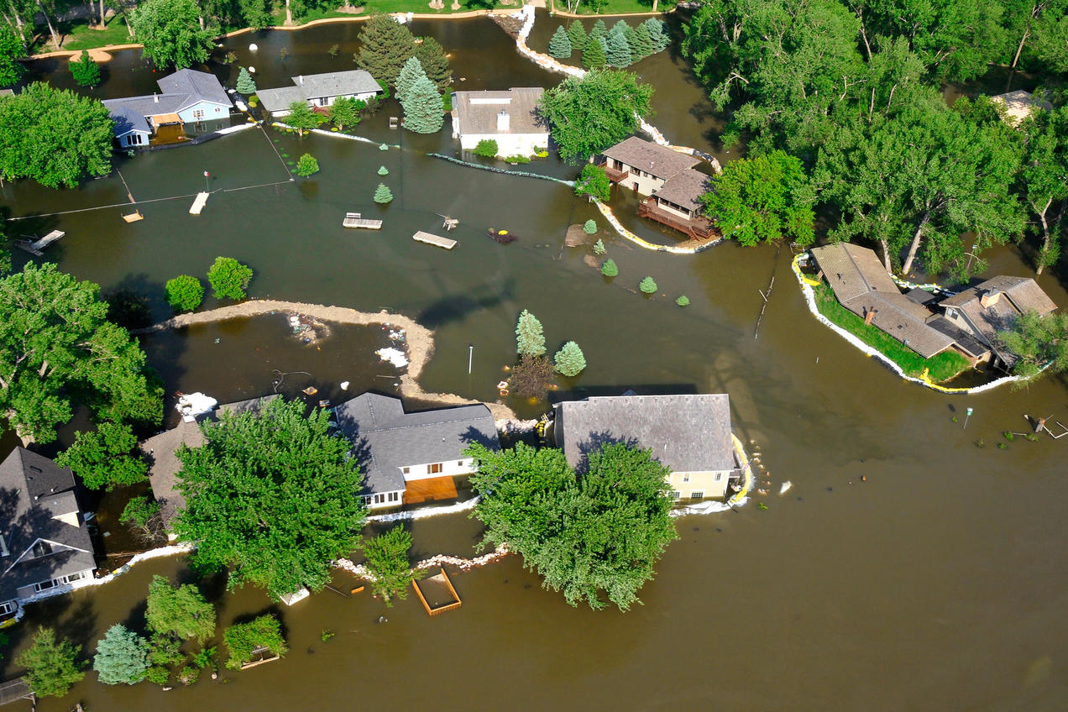
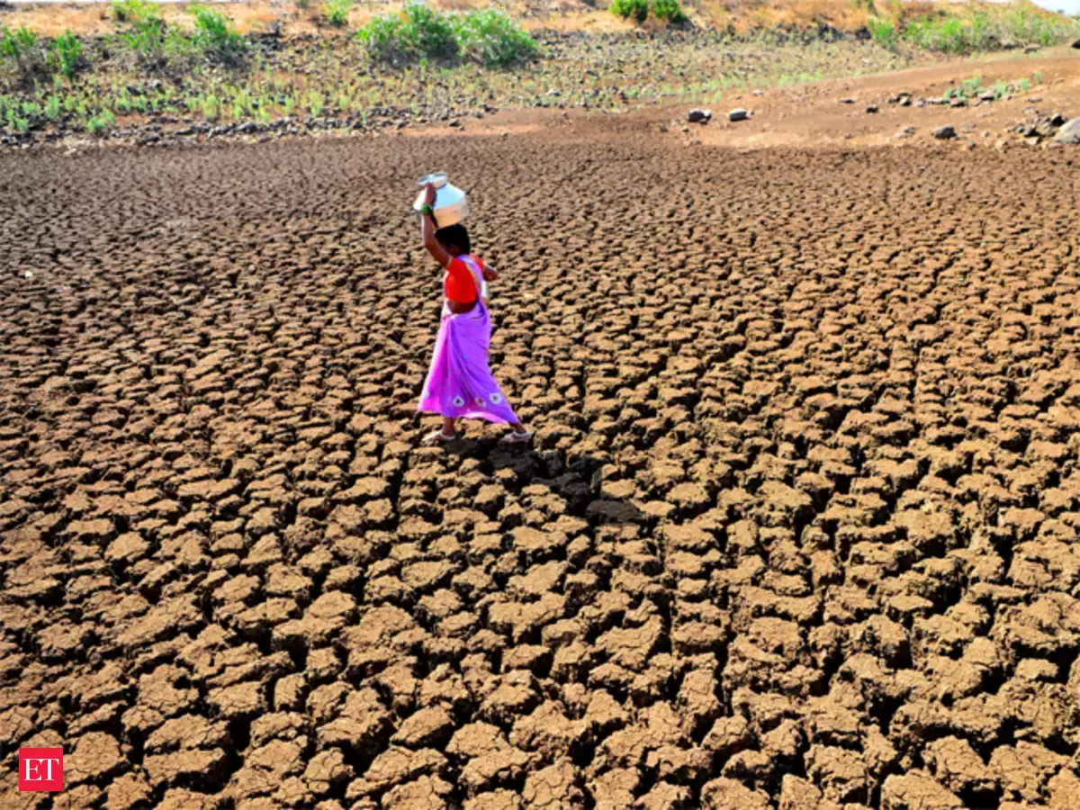

Motivation: Accurate quantification of carbon captured by trees in the forests across the world is essential to the success of the Carbon Credit Market.
Paris Climate Agreement is a legally binding treaty signed by 197 countries to limit climate change.
Renewable sources of energy (zero carbon), Carbon Capture & Storage (CCS) and Carbon Credits are some of the options to address climate change.
Carbon Credits allow individuals, organizations/companies, and Nations to invest in environmental projects worldwide such as smart cities geo_design
Global warming is an existing threat to Humanity

Slide 5
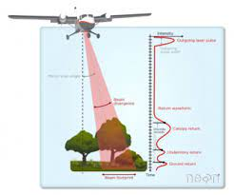
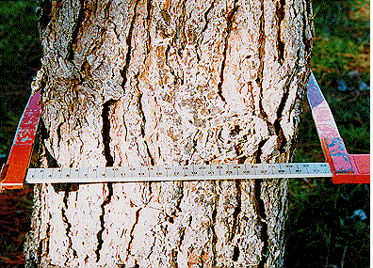
Datasets: To Accurately Predict the Above Ground Biomass (AGB), we need match trees from two different datasets for the SCBI forest site
AGB is “the aboveground standing dry mass of the live or dead trees or shrubs"
Ground Dataset
Aerial Dataset
Data sampled from select forest plots, SCBI dataset
Ground level data includes TreeIds, stem-diameter (dbh) and geo-coordinates
dbh is used to calculate AGB
Field measurements are more accurate.
Contains data for smaller trees (<20m height)
Lidar (aerial) dataset from large forest area, contains measurements for tree crown area, height, geo-coordinates for the tree bounding box
Lidar (aerial) is likely to miss small trees covered by taller trees with larger crowns
Dataset does contain a unique TreeId
The only way to match them is using geo-coordinates from the ground and the aerial dataset.

Slide 6
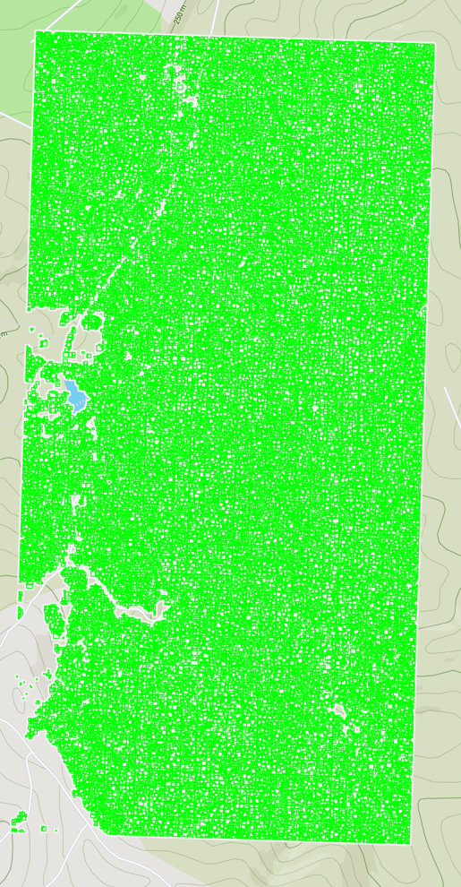
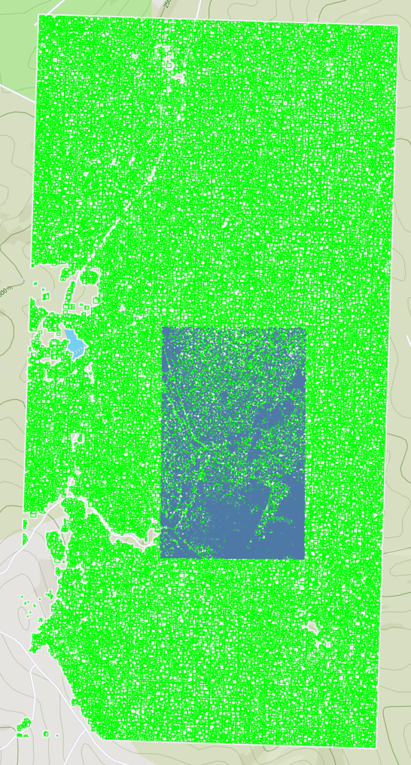
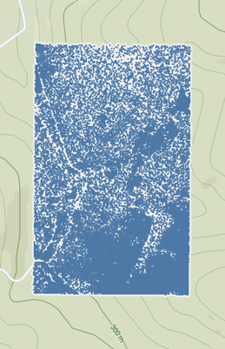
Visualization of Ground and Aerial Datasets
Ground Dataset
Aerial Dataset
Overlay

Slide 7
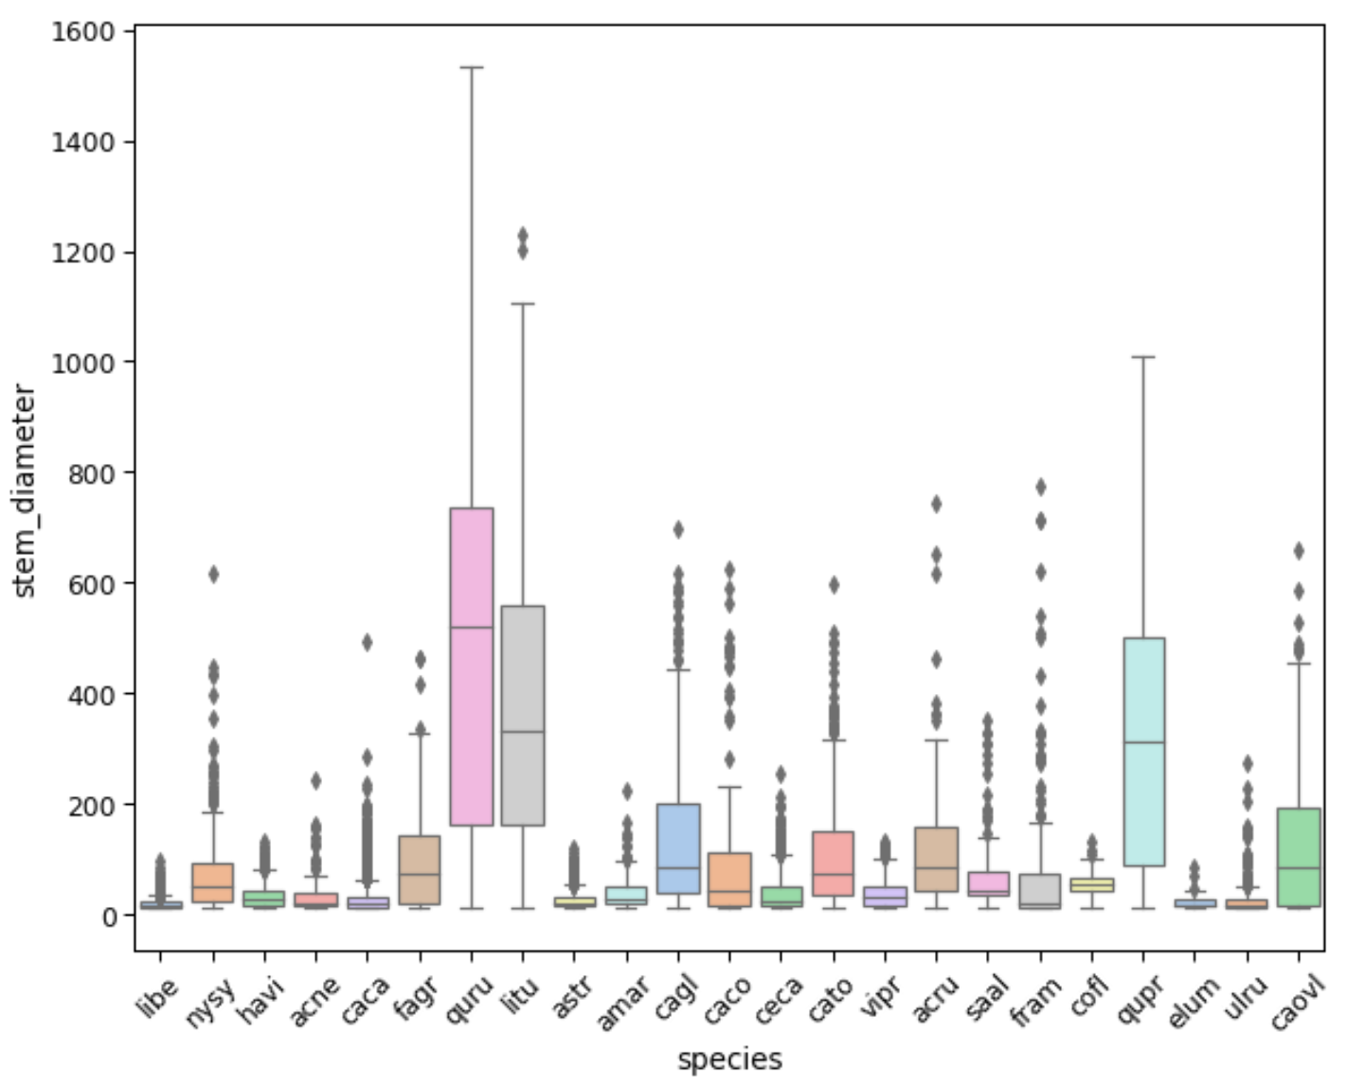
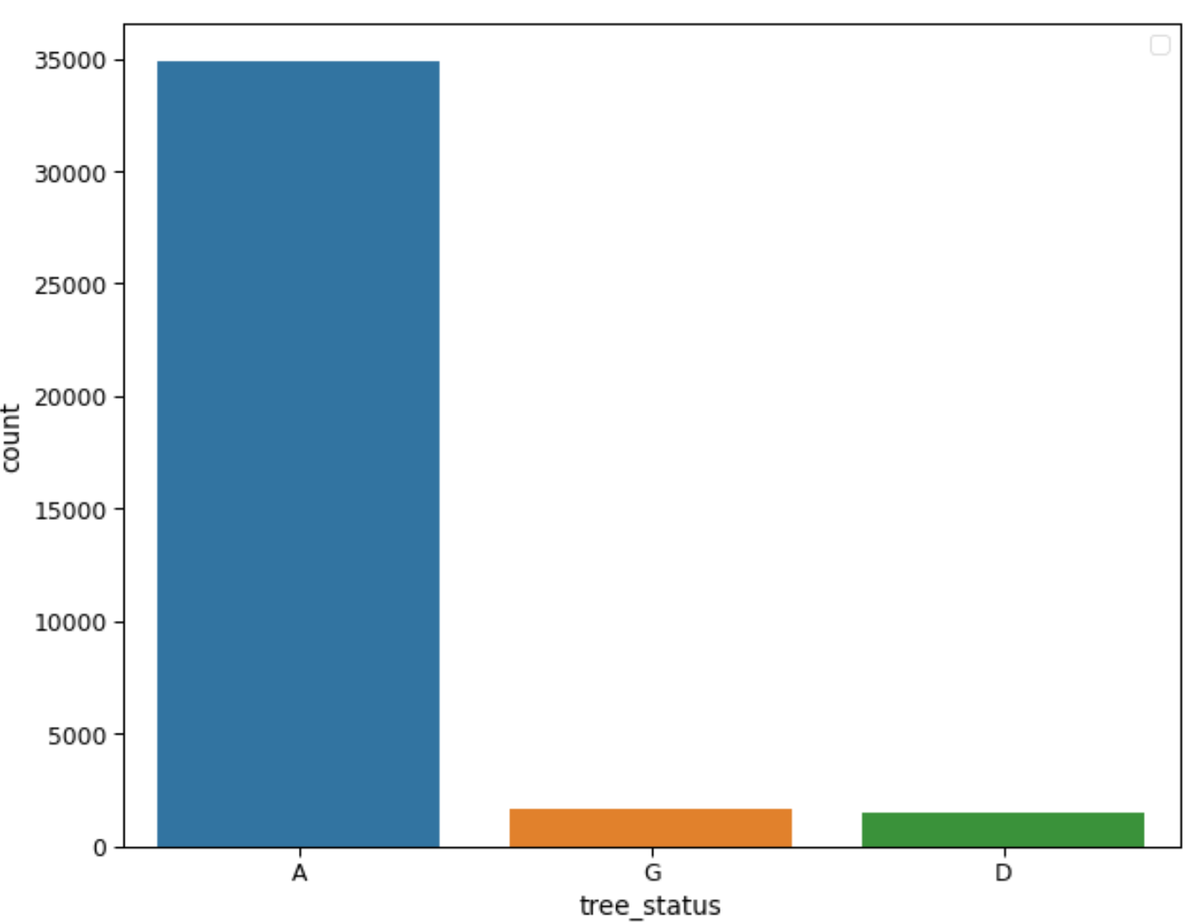
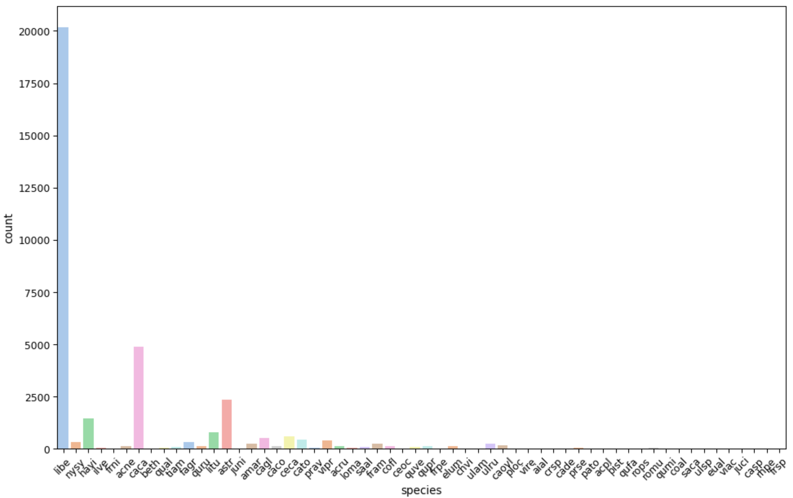
Preprocessing Datasets:
From the Ground Dataset
All broken dead tree observations removed.
All trees with missing data were removed.
All tree with less than 20cm stem_diameter (dbh) were removed.
Significant imbalance in the number of trees by species.
The stem_diameter also varies by species.
Many species have less than 25 trees
'A' - alive, 'D' - dead, 'P' - Not in Census, 'G' - stem is gone

Slide 8
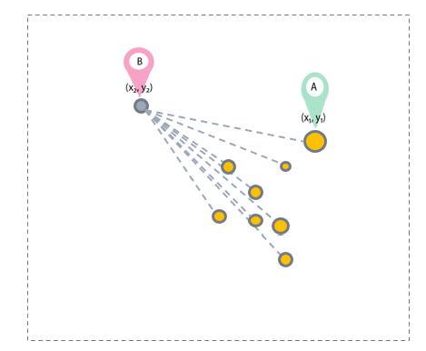
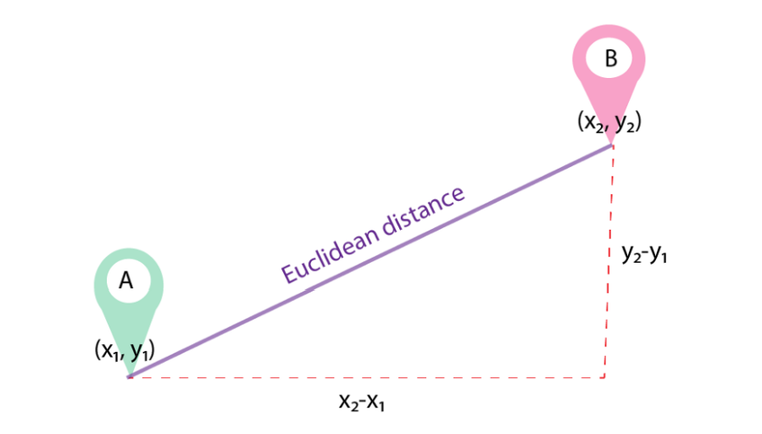
Tree Matching Algorithms
Phase1: Euclidean distance
Phase 2: Bin Matching
A – Ground based dataset Tree geo-coordinates
B – Aerial based dataset Tree geo-coordinates
For aerial tree dataset, X,Y tree center geo-coordinates using the bounding box geo-coordinates
Compute the Euclidean distance between ground tree geo-coordinates and the newly computed X,Y coordinates for a tree from aerial dataset
The aerial tree with shorted distance from the ground tree was selected as the match
An aggregated dataset ground dataset and aerial dataset was created
Aggregated dataset had important features like stem diameter, height, tree crown area and species
This approach showed low accuracy of the models to predict AGB
Using data binning, bucketed the ground data into 5 bins based on stem diameter and the aerial dataset into 5 bins based on tree height
Found all matching trees from the ground dataset that fall within the bounding box of a tree from the aerial dataset.
Selected the tree with highest stem diameter from the candidate matches
An aggregated dataset aerial dataset and ground dataset was created
Aggregated dataset had important features like stem diameter, height, tree crown area and species
This approach improved the accuracy of the models to predict AGB

Slide 9
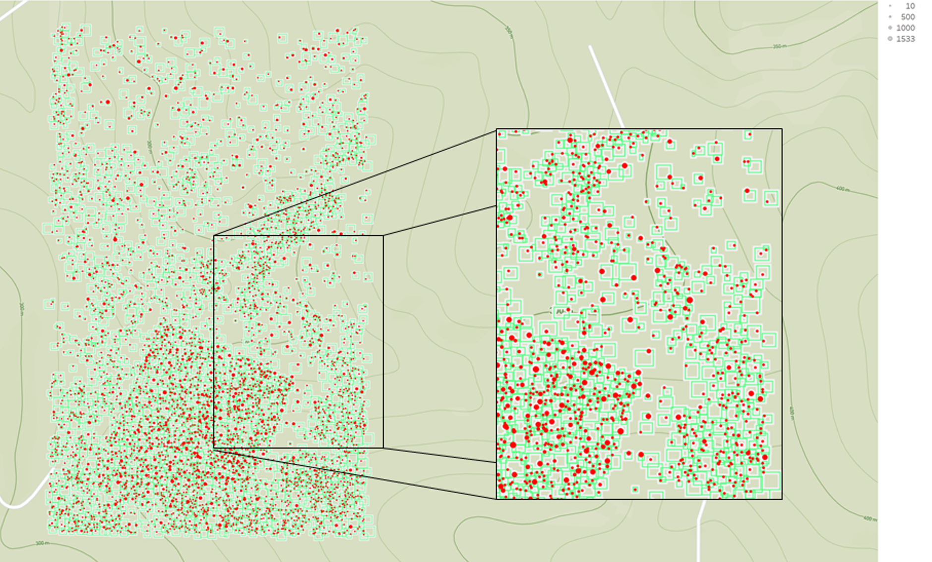
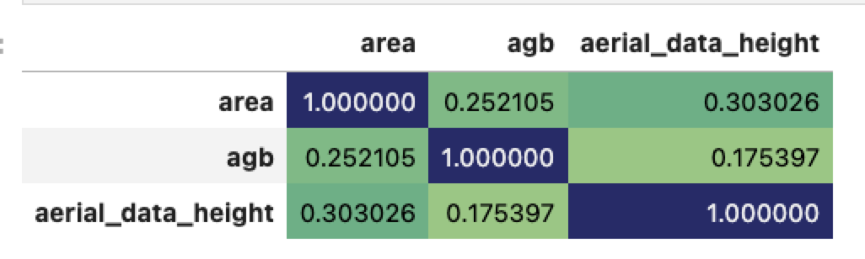
Phase 1 Matching results
Correlation:
AGB ~ Area (0.25)

Slide 10
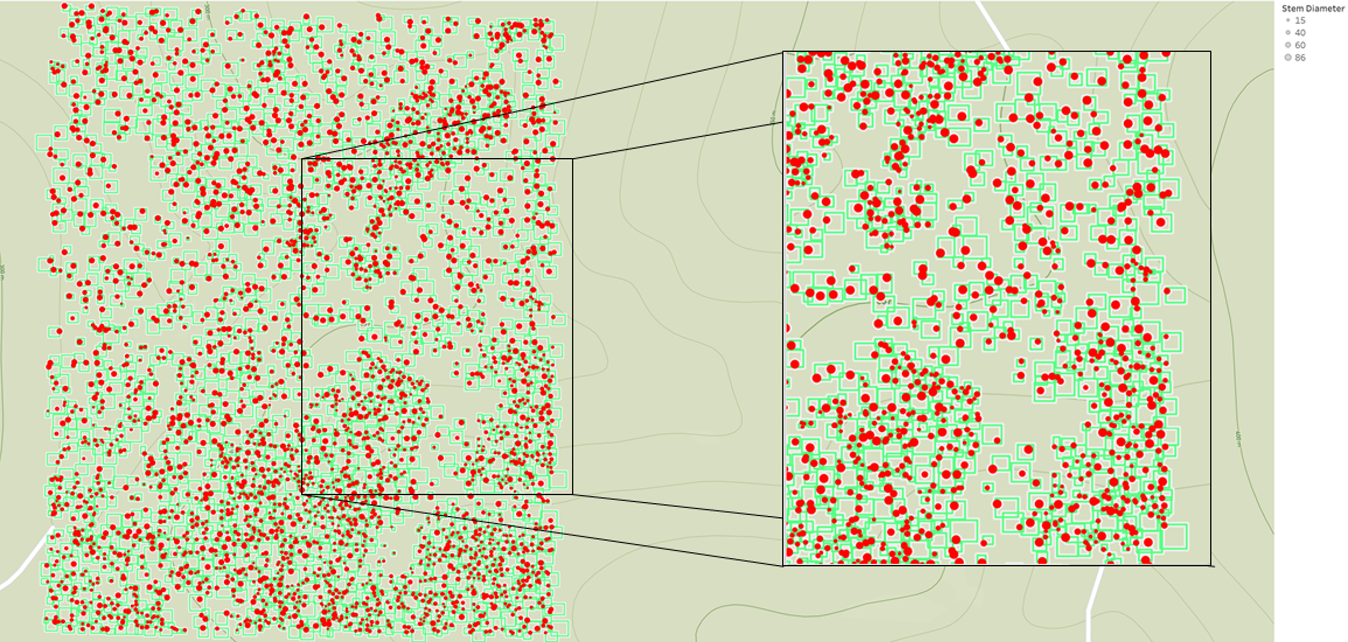
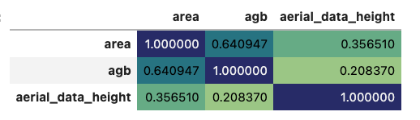
Phase 2 Matching Results
Correlation:
AGB ~ Area (0.64)

Slide 11
Modeling Results
Model | Performance (R Squared) | Error (RMSE)
Random Forest (log AGB ~ area + height) | 0.879 | 0.421
Polynomial Linear Regression (log AGB ~ area(4) + height) | 0.867 | 0.444
Linear Regression (log AGB ~ area + height) | 0.502 | 0.859

Slide 12
Other Experimental Results
Model | Performance (R Squared) | Error (RMSE)
XGBoost (log AGB ~ area + height) | 0.995 | 6.177
Random Forest (log AGB ~ area + height + RGB values) | 0.895 | 0.395
Polynomial Linear Regression (log AGB ~ area(5) + height) | 0.867 | 0.444
Linear Regression (log AGB ~ area + height) | 0.502 | 0.859

Slide 13
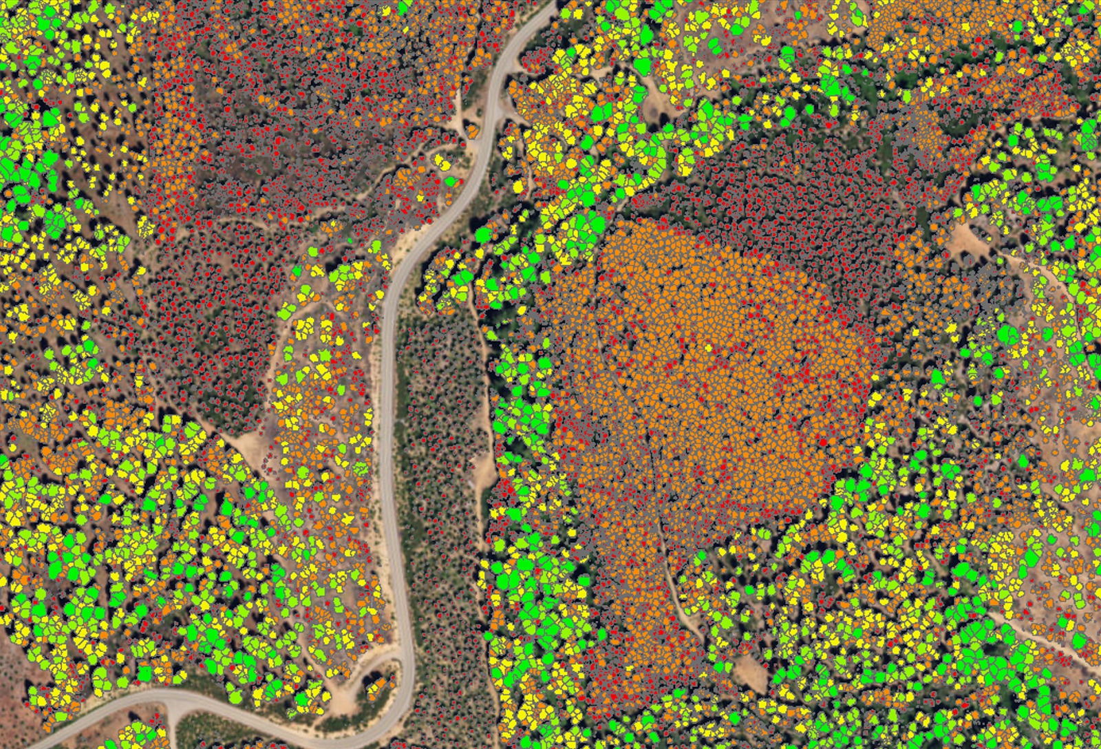
Closing Thoughts
Enrich dataset with satellite-based reflections including spectral band information to enable scaling.
Much of the world is out of reach for ground survey due to cost and other factors
Further refine modeling approach with enriched data
Can we validate validate an approach from aerial data only?
Develop deployable model that can scale to other regions

Slide 14
Q&A Feedback
Thank you

